Slide 1
Search Committee Training
Human Resources 307 Agricultural Administration Building University Park, PA 16802
Phone: 814-863-3452 Fax: 814-863-6215
HUMAN RESOURCES College of Agricultural sciences

Slide 2
Hiring Information
Visit the Ag HR website to review
Hiring Instructions for the College of Ag

Slide 3
Training Highlights
Search Committee Requirements
Advertising
Viewing Applications on EJMS
Reviewing Applications for Minimum Qualifications
Reviewing Applications for Red Flags
Selecting Candidates for Interviews
Diversity Review
Affirmative Action
Developing Interview Questions
Questions Not Permitted in an Interview
Utilizing Behavior-Based Questions
Interview Methods
Documenting Interview Notes
Conducting Reference Checks
Items to Submit to HR
Initiating the Hire
Notifying Applicants Not Hired
Background Checks for New Hires
Maintaining Confidentiality
Contacting Your HRC

Slide 4
Search Committee Requirements
The search committee should have gender and minority representation.
Search committee should consist of at least 3 members. An odd number of members is recommended.
Each search committee member should have reviewed this slideshow and visited the webpages linked within.
A list of search committee members should be sent to HR promptly to set up search committee training for anyone who has not yet completed it.
Search committee members must complete this training before meeting with candidates.

Slide 5
Search Committee Requirements (con’t)
The search committee for a faculty position must be approved by the Dean’s Office.
An Academic Recruitment Form must be completed for faculty searches.
Outlines Department Representation and Committee Composition
Note: This search committee training is required for staff and academic searches. It is not required for part-time vacancies.

Slide 6
Advertising
Advertising is not required for staff positions (other than Extension Educators) but is strongly encouraged.
Tenure Track vacancies require advertising in one publication of national distribution. FT1 and FTM vacancies require advertising in one external source. Advertising outlets for faculty positions must be approved by the Dean’s Office.
Advertisements and position vacancy announcements must be approved by Penn State’s Human Resources Recruitment Team before they can be placed in publications or sent to listservs.

Slide 7
Advertising (con’t)
Publications to consider for advertising to diverse populations:
AsiansinHigherEd.com
BlacksinHigherEd.com
HispanicsinHigherEd.com
LGBTinHigherEd.com
VeteransinHigherEd.com

Slide 8
Viewing Applications on EJMS
Upon completion of this one-time training, search committee members will receive access from HR to view the applicants and their submitted materials.
The applicants can be found on the Electronic Jobs Management System (EJMS).
Sign in with your access account or Friends of Penn State account. (See Slide #9)
Select “View a Job” to be directed to the open position. (See Slide #10)
Select “External” to be directed to the candidates. (See Slide #11)
Select “WEB” to view the Penn State Job Application, “C” to view the cover letter, “R” to view the resume, and “O” to view other materials, such as letters of reference, provided by the applicant.
Applications can be sorted by last name, order received, or candidate number.

Slide 9
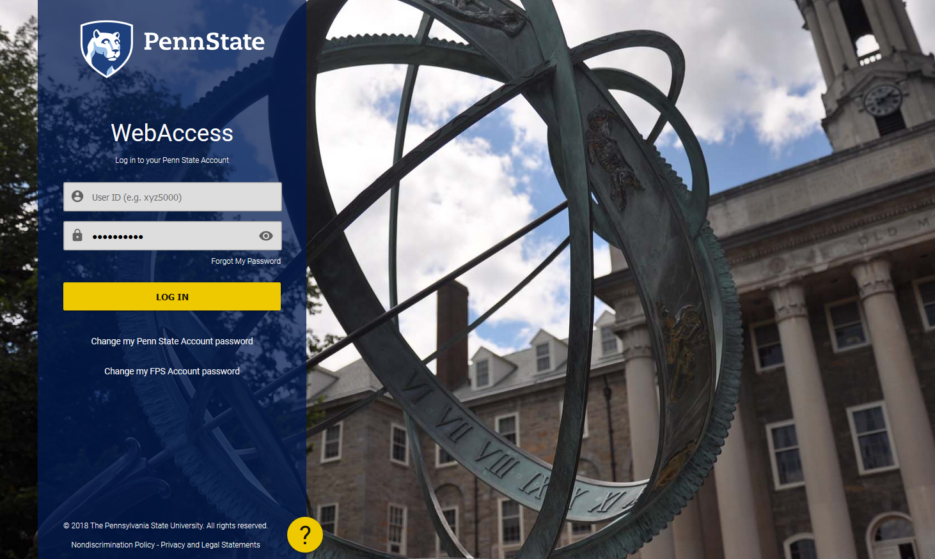
Log in with your User ID and Password

Slide 10
select “View a Job”

Slide 11
Select
“External”
to view applicants

Slide 12
Reviewing Applications for Minimum Qualifications
Review candidate qualifications against the minimum qualifications specified for the job. Consider only those candidates who meet the minimum qualifications.
Equivalent Experience for Degree Required (Staff Positions Only):
Associate’s Degree = 4 years of relevant experience
Bachelor’s Degree = 8 years of relevant experience
Master’s Degree = 12 years of relevant experience
Example: If a position requires an MS + 3 years of relevant experience, the applicant would need a BS + 7 years of relevant experience, an Associate’s + 11 years of relevant experience, or a high school diploma +15 years of relevant experience.

Slide 13
Reviewing Applications for Red Flags
Things to look for on resumes and applications:
How long has the applicant been in previous positions? Is there frequent movement from one job to another?
Why did the applicant leave his/her last job? Are there any red flags?
Are there long breaks in employment? Ask about these breaks when interviewing the applicant.
For staff searches, verify that the applicant is legally permitted to work in the United States without sponsorship.

Slide 14
Selecting Candidates to Interview
Select the most qualified candidates to interview, and notify HR of the individuals selected.
For faculty searches: The department head, prior to reaching out to the applicants, will recommend to the Dean which candidates should be interviewed.
Faculty applicants must submit letter of application, curriculum vitae, academic transcripts, minimum of three letters of reference, and one copy of the position description.
A Short List Approval Form will be required for departments that are considered underrepresented, per the Affirmative Action Office.
For staff positions, this short list should be sent to your Ag HR Consultant for approval prior to scheduling interviews.

Slide 15
Diversity Review
For staff positions, HR will perform a diversity review of all minority applicants in the candidate pool.
If HR feels that a minority is as qualified, or more qualified, than the candidates selected for interview by the committee, justification from the committee will be requested for why the minority applicant was not selected for an interview.
If non-discriminatory justification cannot be provided, the committee will be instructed to offer the minority candidate an interview.
If minority and female candidates apply for a faculty position and are not among the finalists selected for interview, then the department head will provide information to the Dean regarding their applications and the reasons they were not selected.

Slide 16
Penn State’s Affirmative Action Policy
It is the policy of the University to maintain an environment free of harassment and free of discrimination against any person because of age, race, color, ancestry, national origin, religion, creed, service in the uniformed services (as defined in state and federal law), veteran status, sex, sexual orientation, marital or family status, pregnancy, pregnancy-related conditions, physical or mental disability, gender, perceived gender, gender identity, genetic information, or political ideas.

Slide 17
Developing Interview Questions
The search committee should develop a list of job-related questions to ask each candidate.
Use the same interview questions for ALL candidates.
Provide a copy of the interview questions to HR for the Affirmative Action file.
Questions for technical service positions must be approved by Employee Relations prior to use.
During the interview, keep questions focused on the required competencies, knowledge, abilities, qualifications, and experiences of the candidate.

Slide 18
Questions Not Permitted in an Interview
Topics that must be avoided during an interview include:
arrest record
less-than-honorable military discharge
gender
marital status, spousal information (name, education, income)
number and ages of children, child care management, family plans
place of birth/citizenship
English language proficiency (speaking, writing), unless required by the job
other languages spoken, unless required by the job
disabilities, handicaps, prior illnesses and accidents
age/date of high school graduation
weight
religion/church affiliation
social organizations
Pre-employment testing and assessments during the interview process are not permitted unless they are done through contracted temporary employment agencies: Adecco, Express, and Manpower.

Slide 19
Utilizing Behavior-Based Questions
Behavior-based questions should be utilized to identify which candidates possess the traits and characteristics you believe are essential for success in the job.
Avoid using yes-or-no questions, as they inhibit your ability to collect critical information about the candidate by which you will make your hiring decision.

Slide 20
Interview Methods
Screening Interview
This first-round interview is conducted to determine whether or not the applicant has the necessary qualifications.
Phone Interview
Skype Interview
Presentation
In-Person Interview
Please note: All candidates must be offered interviews via the same method.

Slide 21
Documenting Interview Notes
For staff positions, an interview scorecard should be used to document the interview process.
Interview notes are legal documents and must be submitted to Penn State’s Human Resources Recruitment Team for the Affirmative Action file.
Information on the interview score cards should be job-related. Do not include personal information with the interview notes.

Slide 22
Documenting Interview Notes (con’t)
Recording interviews is NOT permitted unless all parties to the conversation have consented.
Two-Party Consent Law
Please see University policy AD53 Privacy Policy and Pennsylvania’s Wiretapping Law for more information.
Failure to abide by these laws and policies can result in criminal penalties and termination of employment.

Slide 23
Conducting Reference Checks
Following interviews, conduct reference checks on the top candidates:
should be completed by search committee chair
required for both internal and external applicants
letters of reference are required for faculty positions
Check at least three references, with an emphasis on former employment references over personal references.
Reference check information should be forwarded to Penn State’s Human Resources Recruitment Team along with the interview notes.
Use the Reference Checklist Sheet (See Slide 24) or your own reference checking tool to record the information gathered.

Slide 24
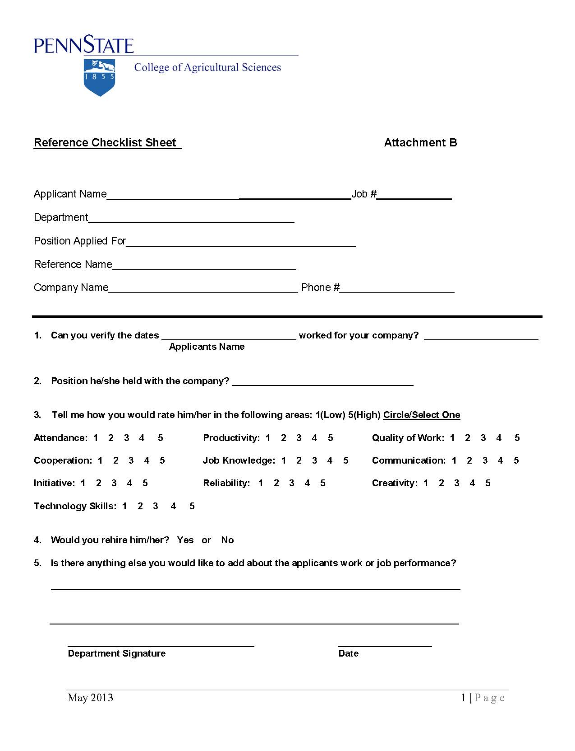

Slide 25
Items to Submit to HR
For Staff Positions:
resume scorecard and interview scorecard for each person interviewed
a copy of your interview questions
reference check information on your top candidates

Slide 26
Initiating the Hire
Upon selecting the most qualified applicant, the search committee chair will work with the appropriate party (HR Consultant for staff positions, Dean for academic positions) to extend an offer.
The Hire Full-Time Employee employment action form in WorkLion will collect the information required to initiate the hire.
AA information will be recorded in the jobs system to produce an Affirmative Action report; therefore, it is critical that HR receive this information from the committee.

Slide 27
Background Checks for New Hires
New hires will complete a standard background check through our vendor, First Advantage.
All new hires that will have direct contact with minors as defined in Policy AD39 are required to obtain the publicly available clearances in lieu of a standard background check. Clearances include:
Pennsylvania State Police Criminal Background Check
Pennsylvania Child Abuse History Clearance
Federal (FBI) Fingerprint Background Check
Some positions may also require additional checks, such as a motor vehicle record (MVR) check or education check. These will be processed through our background check vendor, First Advantage.

Slide 28
Notifying Applicants Not Hired
The search committee chair should contact all of the candidates who were interviewed but not selected to inform them of the committee’s decision.
Applicants who were in the pool but not granted an interview will be notified via an email generated by the EJMS system when the job has closed.

Slide 29
Helpful Resources
Staff Hiring Information
Faculty Hiring Information
Background Check Information
Affirmative Action Office
Extension Hiring Procedures - Available on Extension’s SharePoint site

Slide 30
Remember to maintain confidentiality at all times
What information is confidential?
applicant information and materials
individuals selected for interview/position
specific evaluation methods and questions
committee discussions regarding candidates

Slide 31
Contacting Your HRC
Please contact your College of Ag HR Consultant (HRC) if you have any questions regarding this search committee training.
Let your HRC know when you have completed this training so that your eligibility to serve on search committees can be recorded.

